Slide 1
Profiling Code for Execution Time

Slide 2

Overview
Which part of the code uses the most time?
That’s the best place to start optimization for speed, as it has the largest impact

Slide 3

Sampling a Program
Where are you now? What are you doing?
Keep an array of counter variables, one per function
Periodically sample the program as it runs
Find which function is running
Increment the counter variable for that function
After run, examine the counter array to see which functions dominate execution time
Activity | Count
Studying calculus | 37
Walking/biking/rollerblading | 12
Soldering | 7
Writing code | 55
Eating | 5
Study break | 6
Sleeping | 14

Slide 4
Making the Program Self-Sampling
Where am I now? What am I doing?
Want target program to monitor itself
Periodically samples itself as it runs
Trigger PC sampling with a timer interrupt
See which function was running by finding the ISR’s return address
Increment the counter variable for that function
Target program needs data structures:
Address-to-function translation table
Execution count for each region
Need a helper program to generate address-to-function translation table and integrate into application’s source code

Slide 5
Data Flow for Profiling Support
Get Regions
Executable file holds symbol table with addresses of all functions
Helper program examines executable to make a C file which declares and initializes the region table.
Then rebuild program using updated region table

Slide 6
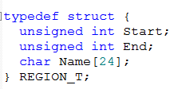
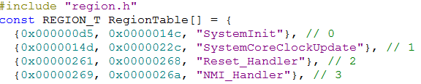
Region Information
Target program needs an array to use (while running) to translate an address to a function name
Getregions program
Analyzes .axf file to find function names, starting addresses and lengths
Generates C code to define and initialize an array of REGION_T elements
Each function is described by an entry in RegionTable
Start: first address used by this region
End: last address used by this region
Region name: simplifies analysis
Place table in ROM (using const) to save RAM space

Slide 7

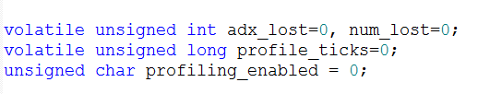
Additional Profile Information
Region count information
RegionCount
Placed in RAM
Updated by ISR during sampling, so declare as volatile
NumProfileRegions
Total number of regions in table
Number of samples taken
profile_ticks
Flag controlling profiling
profiling_enabled
Number of addresses which couldn’t be found in region table
Last address which wasn’t found
Region.c
Profile.c

Slide 8
Extracting function addresses from executable

Slide 9
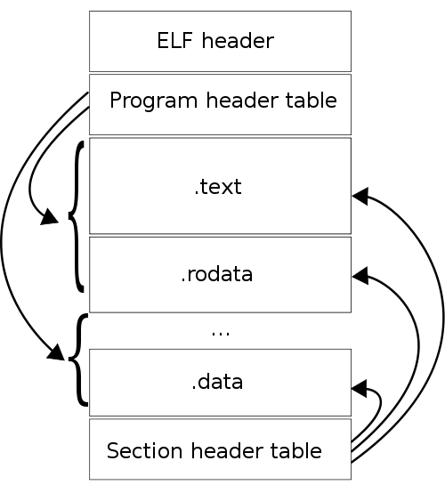
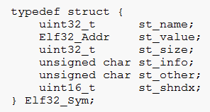
Finding Function Addresses
MDK creates executable image with .axf extension
Format of .axf file is ELF (Executable and Linkable Format)
http://man7.org/linux/man-pages/man5/elf.5.html
Example sections
.text: executable program instructions (machine code)
.data: initialized data
.bss: uninitialized data (actually cleared to zero)
.symtab: symbol table for debugging
.strtab: string table with names of sections and symbols
Symbol Table
Holds information for each symbol (e.g. function)
st_value: beginning address of symbol
st_size: size of symbol
st_name: location of symbol’s name in string table
Image: Wikipedia

Slide 10
Using Getregion
Build your program in uVision.
Run update_regions_manually.bat (in the Scripts folder) to create a new region.c file (which is placed in the src folder). This file will have the correct number of entries but the addresses may be wrong (this is ok – a later pass will fix this).
Rebuild your program in uVision to generate an executable with the correct size region table. Note that this table still uses the old function addresses, which will be wrong if the previous region table had a different number of entries.
Run update_regions_manually.bat to create a new region.c file with the correct function addresses and the correct number of entries.
Rebuild your program in mVision to generate an executable with the correct region addresses.
Download and execute your program on the target hardware. This will populate the RegionCount table to indicate the execution time profile.

Slide 11
Retrieving the Return Address and finding the function

Slide 12
Identifying the Interrupted Function
Demo code uses PIT to generate periodic interrupt
Within timer ISR:
Read the return address from the stack
Examine table of region addresses to determine currently executing region i
Increment entry i of execution count table
Extras
Increment a total number of ticks variable (to reveal out-of-range PC instances) – want to be able to double-check the measurements
Keep track of last address which was not found

Slide 13
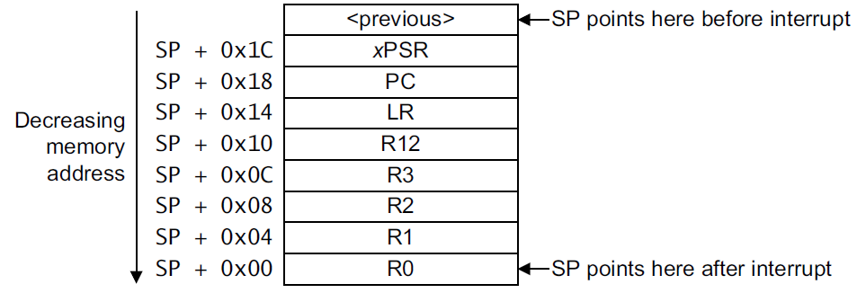
Finding Return Address in ISR
1. SP points here before interrupt
2. SP points here upon entering ISR
ISR stack frame contents
3. SP points here at start of ISR function body
Where is the return address stored?
Not in LR – that holds an exception return code in ISRs
Instead need to access saved PC value on stack
Where is it on the stack?
Offset from SP depends on when we access it, since SP changes

Slide 14

Finding Return Address in ISR
Can’t use intrinsic __return_address()
Returns value of link register, used to return from subroutine calls, not ISRs
Instead read saved PC value from stack
Use compiler’s __current_sp() intrinsic to read current value of SP
Add offset for context saved by hardware in response to interrupt (RET_ADX_OFFSET)
Add offset for ISR’s additional stack frame contents (CUR_FRAME_SIZE)
Load the word from resulting memory address
Resulting object code
Look at what that long line of C code turned into! Very efficient object code.
Define constant values in profile.h
RET_ADX_OFFSET = 0x18
CUR_FRAME_SIZE = ? -> Need to compile function and inspect object code

Slide 15
Object Code Inspection
;;;15 void PIT_IRQHandler() {
000000 b430 PUSH {r4,r5}
000002 2001 MOVS r0,#1
000004 4955 LDR r1,|L1.348|
000006 0580 LSLS r0,r0,#22
000008 6008 STR r0,[r1,#0]
00000a 4855 LDR r0,|L1.352|
00000c 68c1 LDR r1,[r0,#0xc]
00000e 07c9 LSLS r1,r1,#31
000010 d032 BEQ |L1.120|
000012 68c1 LDR r1,[r0,#0xc]
000014 07c9 LSLS r1,r1,#31
000016 0fc9 LSRS r1,r1,#31
000018 60c1 STR r1,[r0,#0xc]
00001a 4852 LDR r0,|L1.356|
00001c 7800 LDRB r0,[r0,#0]
00001e 2800 CMP r0,#0
000020 d028 BEQ |L1.116|
;;;30 PC_val = *((unsigned int *) (__current_sp()+CUR_FRAME_SIZE+RET_ADX_OFFSET));
000022 4668 MOV r0,sp
000024 6a01 LDR r1,[r0,#0x20]
Look for instructions (between ISR entry and return address calculation) which modify stack pointer
PUSH, POP, changes to sp (r13))
Determine how each instruction modifies the stack pointer
PUSH {r4,r5}
pushes 2*4 bytes, so set CUR_FRAME_SIZE to 8

Slide 16
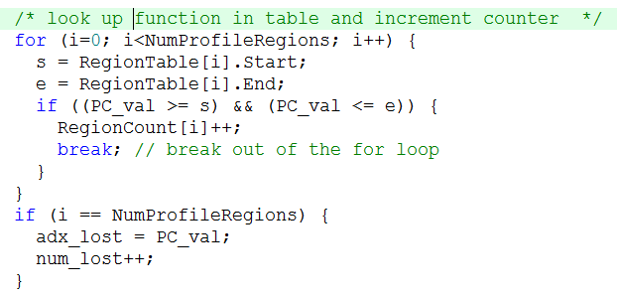
Looking Up The Address
This function executes frequently and should be optimized
Could sort entries, starting with most frequently executed regions
“Profile-driven profiler optimization!”
Uses a linear search
Change to binary search? Need to sort regions in address order

Slide 17
Demonstration

Slide 18
Profiler API and Use
void Init_Profiling(void)
Clears RegionCount table
Initializes and starts timer
void Disable_Profiling(void)
Clears profiling_enabled flag
void Enable_Profiling(void)
Sets profiling_enabled flag
Program responsibilities
Initialize profiling system and timers with Init_Profiling()
Ensure interrupts are enabled with __enable_irq()
Enable profiling
Run code in question
Disable profiling

Slide 19
Build Sequence
Get Regions
Build the program using a dummy region.c file. Region.c has wrong number of regions, wrong addresses.
Run tool to create the region table from the executable. Region.c has right number of regions, but wrong addresses.
Rebuild the program. The resulting executable symbol table has the correct function addresses.
Run tool to create the region table from the executable. Region.c has right number of regions, right addresses.
Rebuild the program. Executable’s region table has right number of regions, right addresses

Slide 20
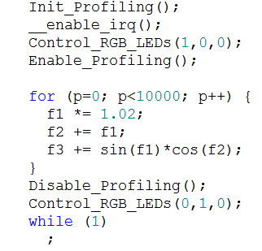
ProfileDemo
Where does this program spend most of its time?
f1, f2 and f3 are floats
Each loop has
2 FP adds
2 FP multiplies
1 FP sine
1 FP cosine
Build program, download, run
Break at while (1) loop
Examine RegionCount and profile_ticks

Slide 21
Disadvantages of Sampling
Sampling is inexact - not guaranteed to get everything that runs
Code which disables interrupts (e.g. ISRs, OS code) is not measured
Rarely executed code may be missed
Takes time for numbers to settle down
Profile changes based on mode of program
How long is enough?
The statistician I asked said “Well, it depends,” and changed the subject
A complex statistical question!
If this were a statistics class, we probably would never actually get to running the program…
So, run it until the digits you care about stop changing.
9%? 9.7%? 9.73%? 9.731%? 9.731123452345245%?
Each additional digit will take more time to stabilize

Slide 22
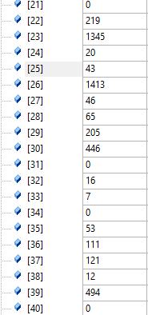
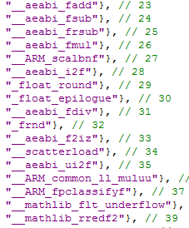
Results
profile_ticks = 5329 (number of samples)
Top region is #26
1413 samples/5329 = 26.5%
Look up #26 in RegionTable – is _aeabi_fmul (floating-point multiply)
2nd region is #23
1345 / 5329 = 25.2%
__aeabi_fadd (fp add)
3rd region is #39
494 / 5329 = 9.3%
__mathlib_rredf2 (?)
RegionCount
RegionTable

Slide 23


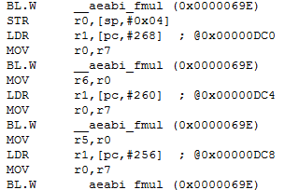
How long do the sin and cos calls take?
RegionTable
Look them up in RegionTable
Entries 45 (sinf) and 44 (cosf)
Then look in RegionCount
Sinf: 264/5329 = 4.95%
Cosf: 248/5329 = 4.64%
Are those functions really that fast? 2.5x faster than multiply or add?
No they aren’t!
Look at object code for sinf in disassembly window
Many calls to fmul and other functions
RegionCount
sinf Disassembly

Slide 24
Flat vs. Cumulative Profile
sinf
fmul
frnd
f2iz
fmul
frsub
fsub
rredf2
Flat profile
A function F accumulates time only if the PC address sample is in function F
Cumulative profile
A function F accumulates time
If the PC address sample is in function F
If the PC address sample is in a function G, which F called (directly or indirectly)
All functions above G in the call tree also accumulate time
This can be done by examining all return addresses on the call stack
Not implemented here
Extra credit project!
Approximation
Modify function of interest to set an output bit on entry, clear it on exit
Examine bit with oscilloscope, measure duty cycle

